Slide 1
MGT 608 – Information and Supply Chain Systems
Week 4, Lesson 1
Transportation Management

Slide 2
Review of Week 3
Topics
  Logistics
  Information Systems for Logistics
  Inventory Management
Assignments

Slide 3
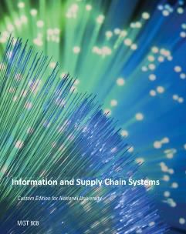
Preview of Week 4
Chapter 11: Transportation
Chapter 12: Supply Chain Management

Slide 4
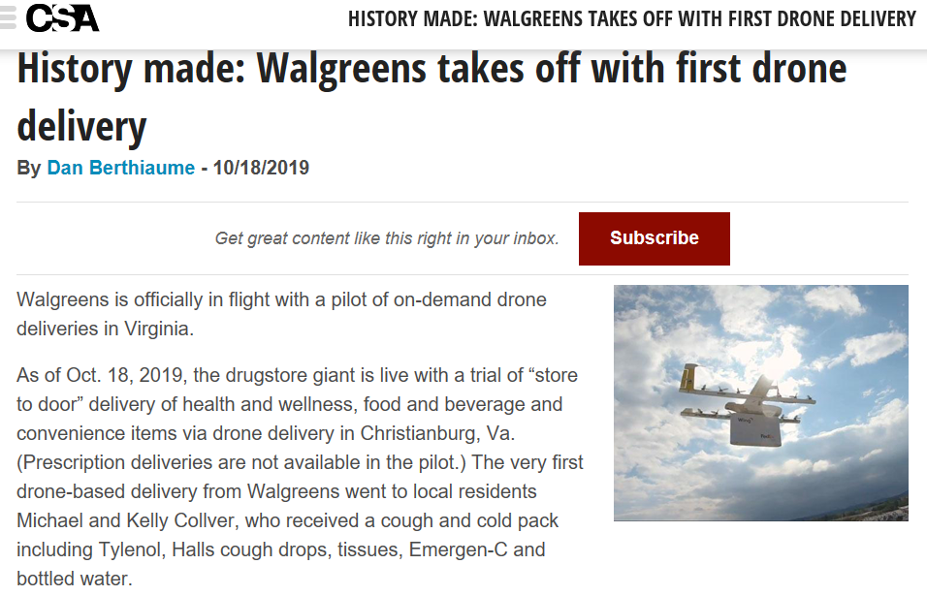

Slide 5
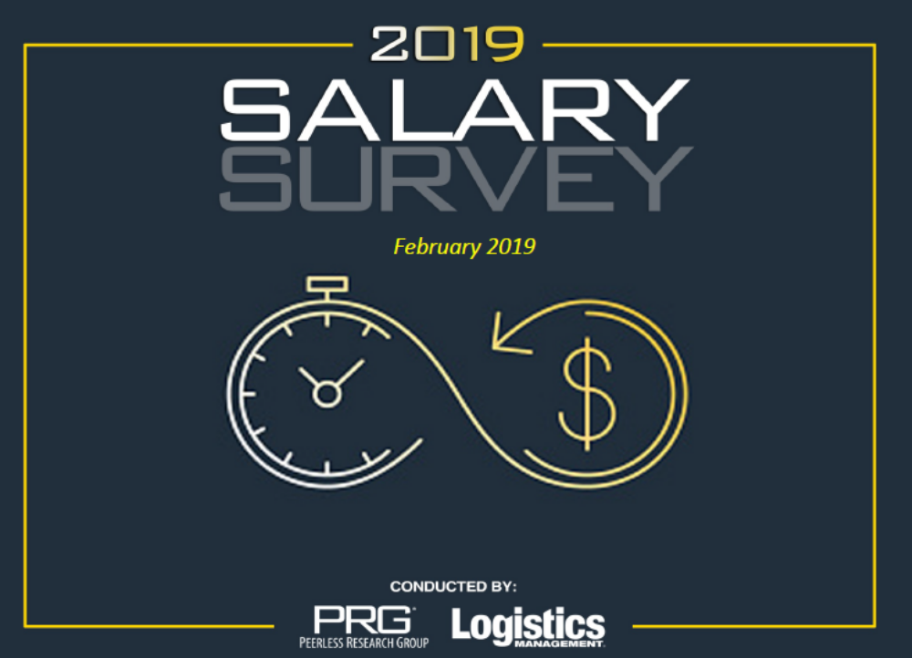

Slide 6
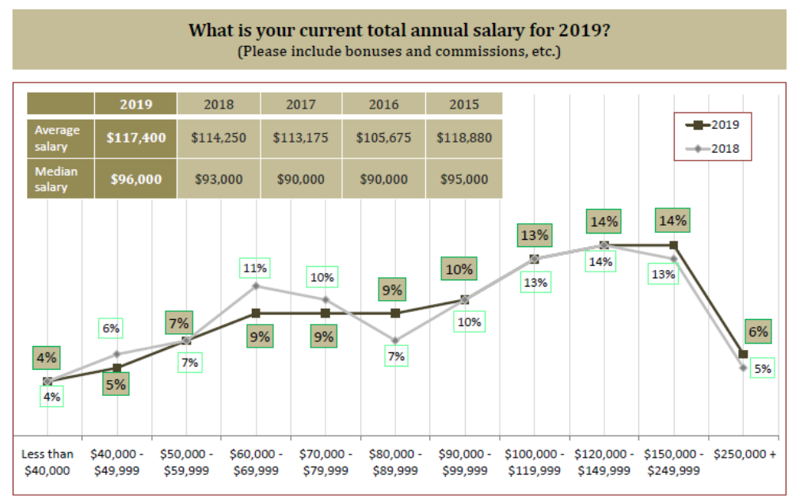

Slide 7
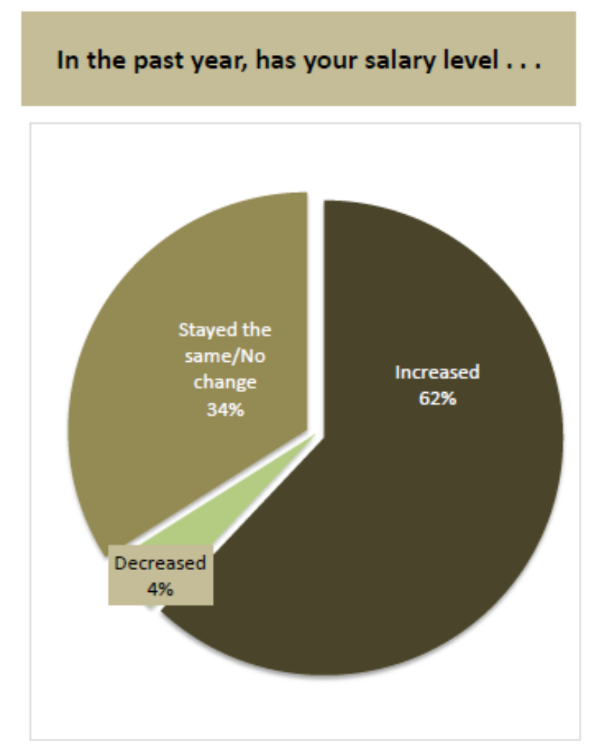

Slide 8
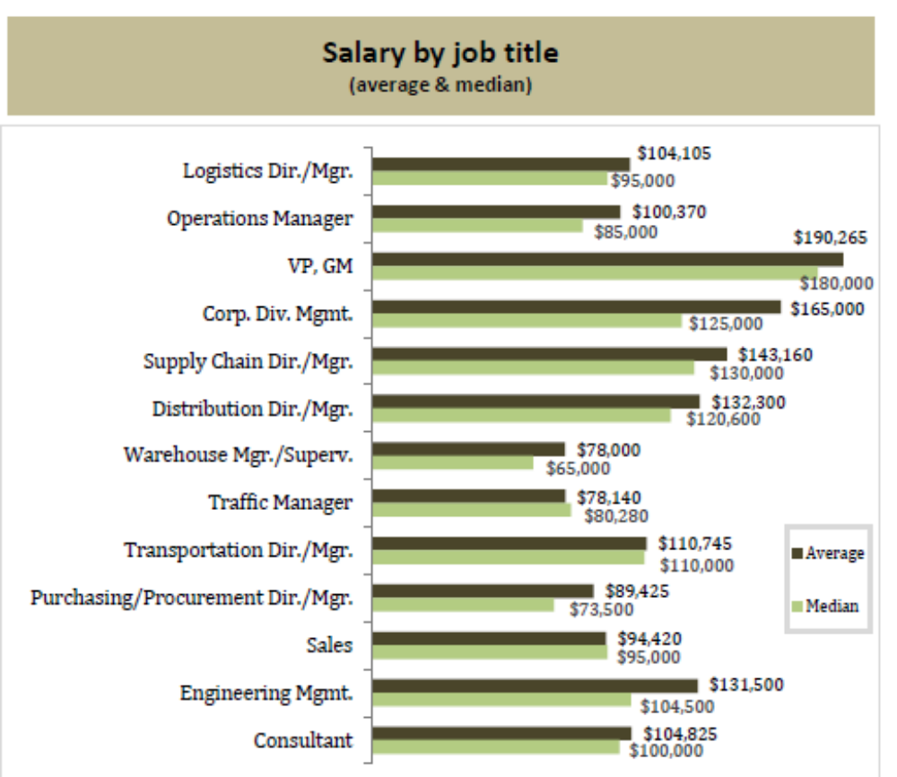

Slide 9
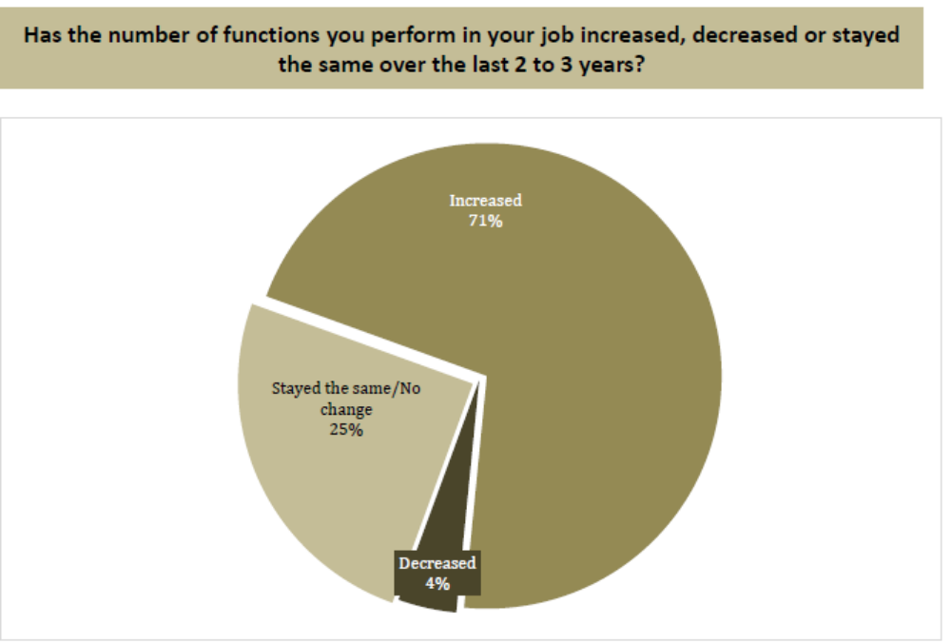

Slide 10
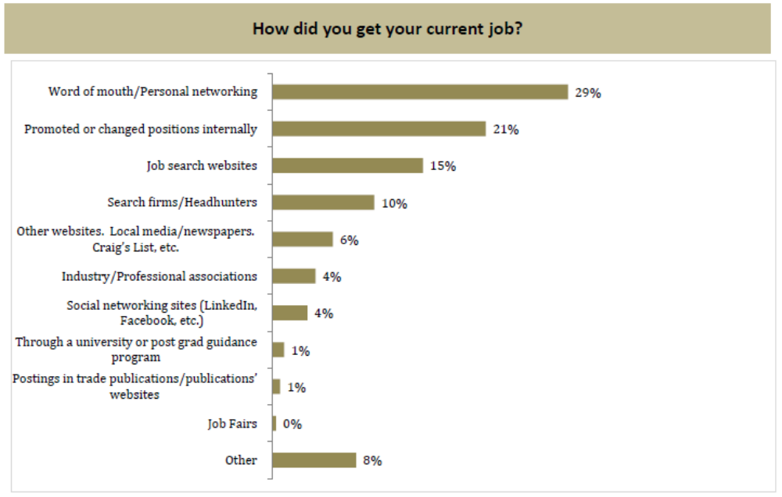

Slide 11
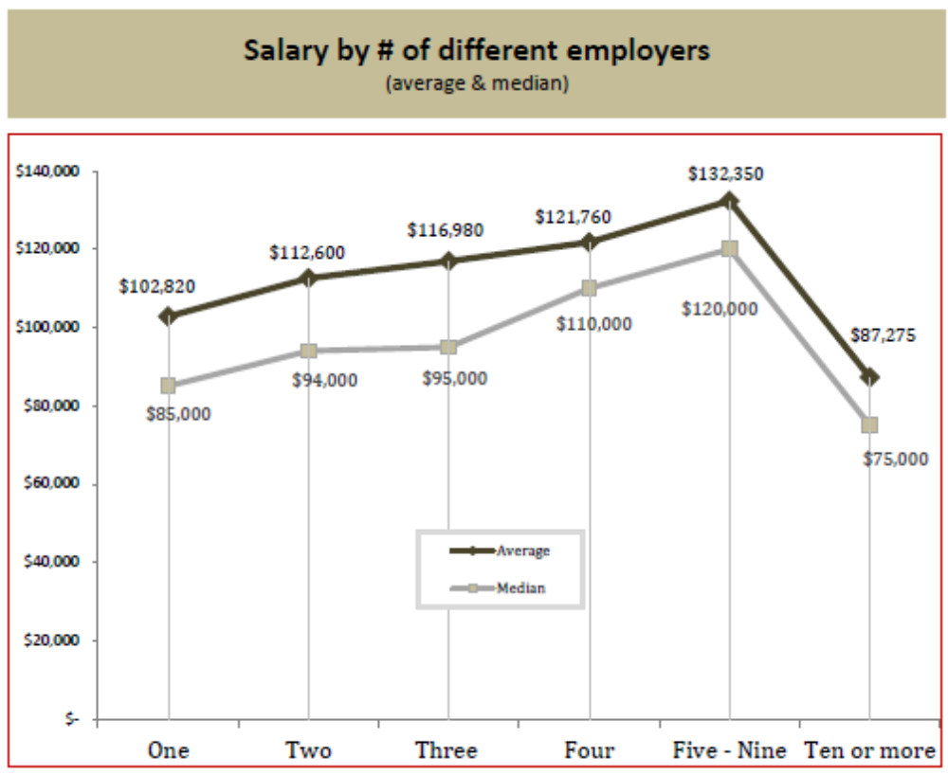

Slide 12
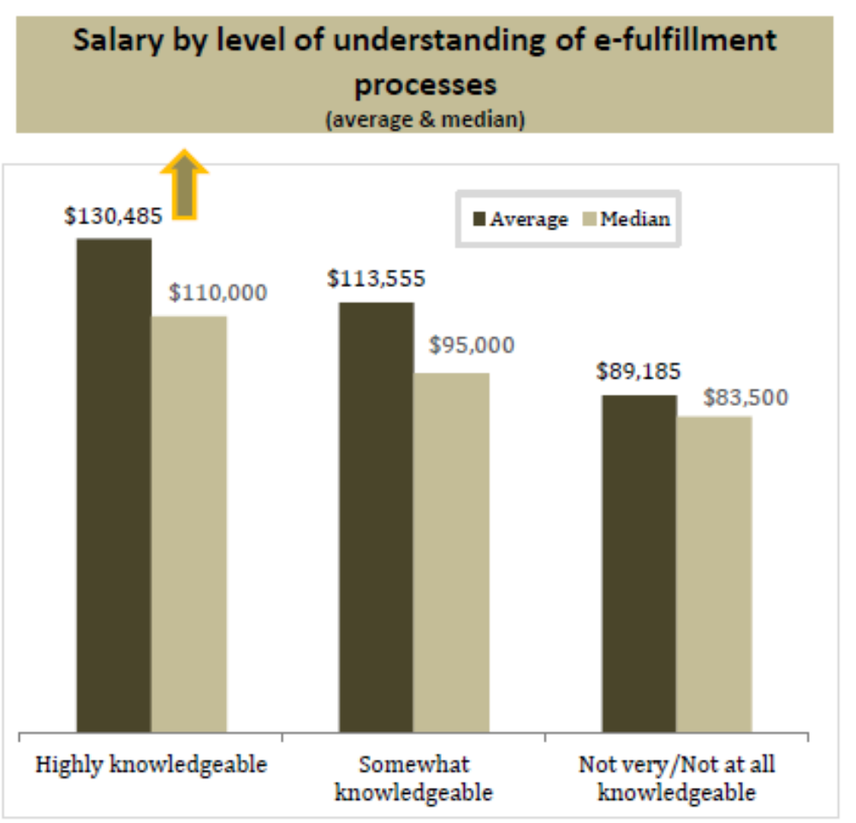

Slide 13
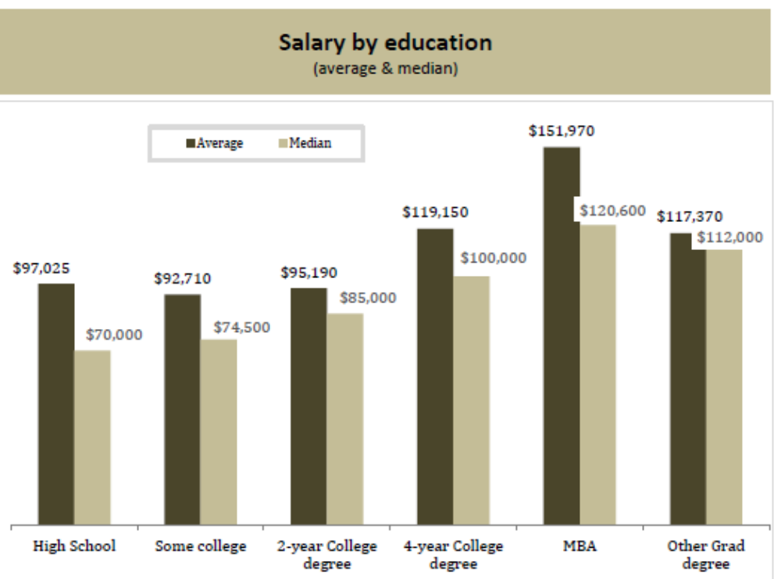

Slide 14
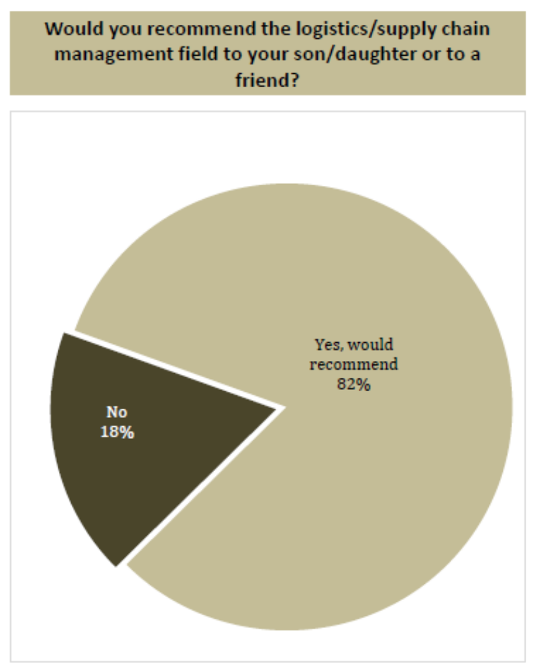

Slide 15
Current Events !!!
Louis goes first….

Slide 16
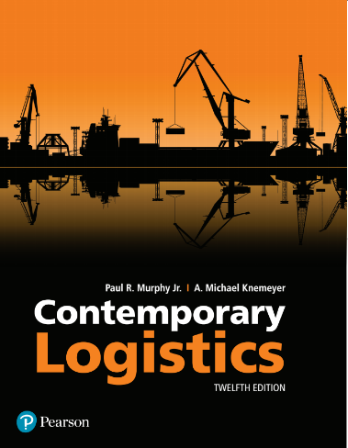
Contemporary Logistics
Twelfth Edition
Chapter 11
Transportation
Copyright © 2018, 2015, 2012 Pearson Education, Inc. All Rights Reserved.

Slide 17
Learning Objectives
1 To compare and contrast transportation infrastructures
in several countries
2 To identify the five modes of transportation and learn
about their respective characteristics
3 To discuss intermodal transportation
4 To describe several types of transportation specialists
5 To explain how different types of regulation impact
transportation
6 To identify the legal classification of transportation
carriers
Notes:
Slide 2 is list of textbook LO numbers and statements

Slide 18
Transportation (1 of 4)
Transportation
  The actual, physical movement of goods and people between two points

Slide 19
Transportation (2 of 4)
Transportation influences the following logistics activities:
  location of the firm’s plants, warehouses, vendors, retail locations, and customers
  inventory requirements
  packaging
  materials handling equipment and the design of receiving and shipping docks
  consolidation of shipments
  type and quality of carrier and carrier service selected by the seller

Slide 20

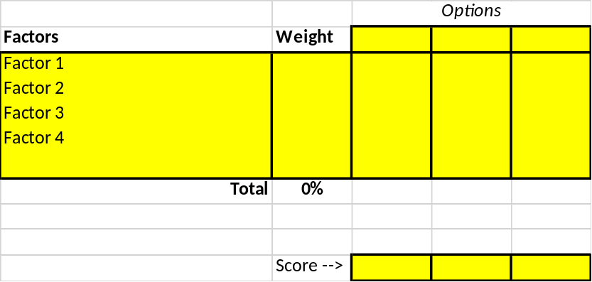
Learning Activity
Global Location Decision Model

Slide 21
Transportation (4 of 4)
Five different types, or modes, of transportation include:
  Air
  Motor carrier (truck)
  Pipeline
  Rail
  Water
6th Mode:
Intermodal

Slide 22
Transportation Infrastructure
Wide disparities in the various infrastructures exist between highly populated countries
Lack of infrastructure makes it difficult to use that transportation mode domestically

Slide 23
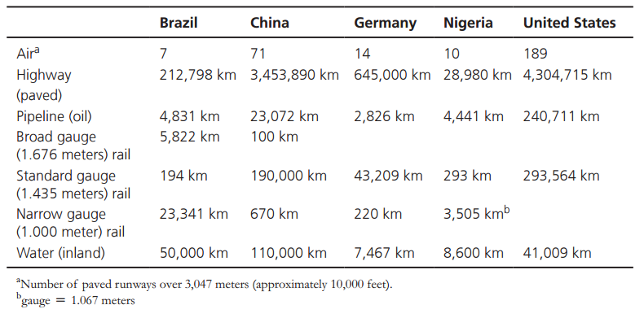
Table 1: Infrastructure Statistics in Several Countries
Source: The World Factbook, www.cia.gov, 2016.

Slide 24
Transportation Modes (1 of 16)
The attractiveness of a particular mode depends on the following attributes:¹
  Cost
  Speed
  Reliability
  Capability
  Capacity
  Flexibility
¹Drawn from David J. Bloomberg, Stephen LeMay, and Joe B. Hanna, Logistics (Upper Saddle River, NJ: Prentice Hall, 2002), Chapter 7.

Slide 25
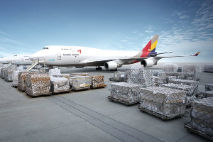
Transportation Modes (2 of 16)
Airfreight
  Generally the fastest mode for shipment exceeding 600 miles
  Expensive
  Accessorial service, if needed, adds transportation cost and time
  Best suited for high-value, lower-volume urgent, perishable, or time-specific deliveries
  Dimensional weight used for rates

Slide 26
Transportation Modes (3 of 16)
Airfreight
  Examples of products that move by air:
    Auto parts and accessories
    Cut flowers and nursery stock
    Electronic or electrical equipment (e.g., iPods)
    Fruits and vegetables
    Machinery and parts
    Metal products
    Photographic equipment, parts, and film
    Printed matter
    Wearing apparel

Slide 27
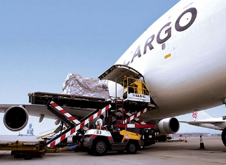
Transportation Modes (4 of 16)
Airfreight
  Reliability is problematic due to delays caused by:
    Congestion and resultant delays with air passenger transportation (belly freight)
    Weather (e.g., fog, snow, thunderstorms)

Slide 28
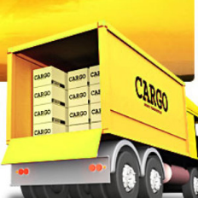
Transportation Modes (5 of 16)
Motor carriers
  Most important business user of the Interstate Highway System
  Primary advantage is flexibility
  Cost is generally lower when compared to airfreight
  Less-than-truckload (LTL) versus truckload (TL)

Slide 29
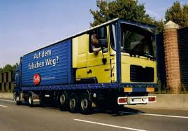
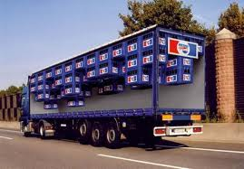
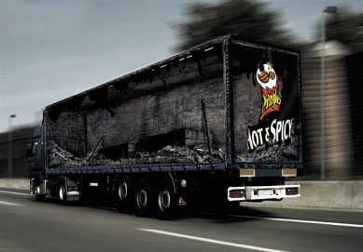

Slide 30
Transportation Modes (6 of 16)
Motor carriers
  Less-than-truckload (LTL)
    150 to 10,000 pounds
    Too big to be handled manually; too small to fill a truck
    LTL trucks carry shipments from many shippers
    Operate through a system of terminals
    Prominent LTL carriers include:
      ABF Freight System
      FedEx Freight
      UPS Freight
      YRC Freight

Slide 31
Transportation Modes (7 of 16)
Motor carriers
  Less-than-truckload (LTL)
    Process
      From each terminal small trucks go out to customers, delivering and picking up shipments
      Shipments are taken to a terminal where loaded to line-haul trucks
      Line-haul to terminal near destination
      Shipments loaded to smaller trucks for local delivery

Slide 32
Transportation Modes (8 of 16)
Motor carriers
  Truckload (TL)
    Focus on shipments less than 10,000 pounds
    Exact weight depends on the product
    Close to the amount that would physically fill a truck trailer
    Possible that large shipments from several customers can be consolidated

Slide 33
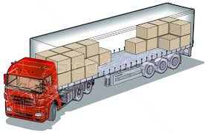
Transportation Modes (9 of 16)
Motor carriers
  Truckload (TL)
    Prominent TL carriers include:
      J.B. Hunt
      Schneider National
      Swift Transportation
      Werner Enterprises

Slide 34
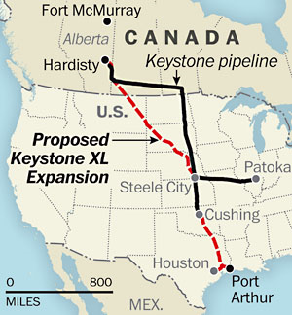
Transportation Modes (11 of 16)
Pipelines
  Only mode without vehicles
  No need for vehicle operators
  Transportation is one way
  Most reliable mode

Slide 35
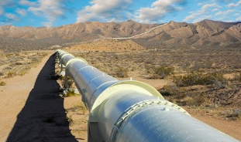
Transportation Modes (12 of 16)
Pipelines
  Tend to be the slowest mode
  Accommodates only liquid, liquefiable, or gaseous products
  Capable of transporting large product volumes
  High fixed costs, but relatively low cost per unit due to large product volume

Slide 36
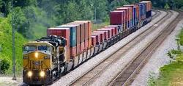
Transportation Modes (13 of 16)
Railroads
  U.S. dominated by four freight carriers:
    Burlington Northern (west of the Mississippi)
    CSX (east of the Mississippi)
    Norfolk Southern (east of the Mississippi)
    Union Pacific (west of the Mississippi)

Slide 37
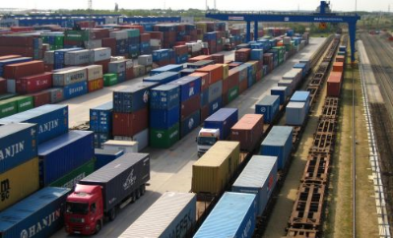
Transportation Modes (14 of 16)
Railroads
  Less flexibility than motor carriers
  Superior to air and motor with regards to volume
  Less expensive than air and motor
  Faster than pipeline and water

Slide 38
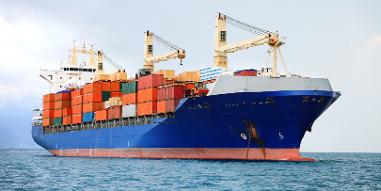
Transportation Modes (16 of 16)
Water
  Somewhat unreliable
    Drought
    Icing
    Aging lock system
  Slow average speeds
  Relatively inexpensive
  Focuses on lower value bulk commodities handled by mechanical means
  Many different kinds of products can be carried
  Carries greater volumes than rail or truck

Slide 39
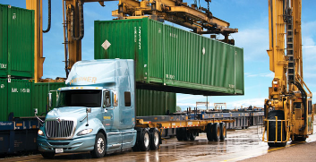
Intermodal Transportation (1 of 4)
Intermodal transportation
  Refers to transportation when using a container or other equipment that can be transferred from the vehicle of one mode to the vehicle of another mode without the contents being reloaded or disturbed²
²This definition comes from Barton Jennings and Mary C. Holcomb, “Beyond Containerization: The Broader Concept of Intermodalism,” Transportation Journal 35, no. 3 (1995): 5–13.

Slide 40
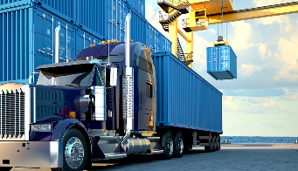
Intermodal Transportation (2 of 4)
Intermodal transportation
  Two or more modes work closely together to utilize advantages of each mode while minimizing their disadvantages
  Example:
    Piggyback transportation
      Trailer-on-flatcar
      Container-on-flatcar

Slide 41
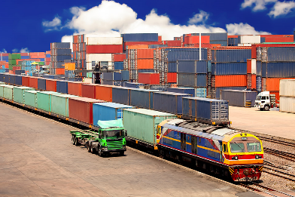
Intermodal Transportation (3 of 4)
Containers
  Moved by mechanical devices (e.g., container crane)
  Provide significant reduction in freight handling costs
  Are interchangeable among rail, truck, and water carriers

Slide 42
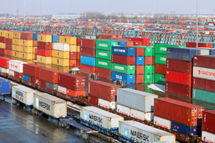
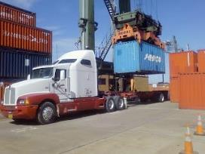
Intermodal Transportation (4 of 4)
Containers
  Airfreight containers (unit load devices, or ULDs) are designed specifically for fuselage
  Are measured by TEUs (20-foot equivalent unit)
  Allowed for land bridge services

Slide 43
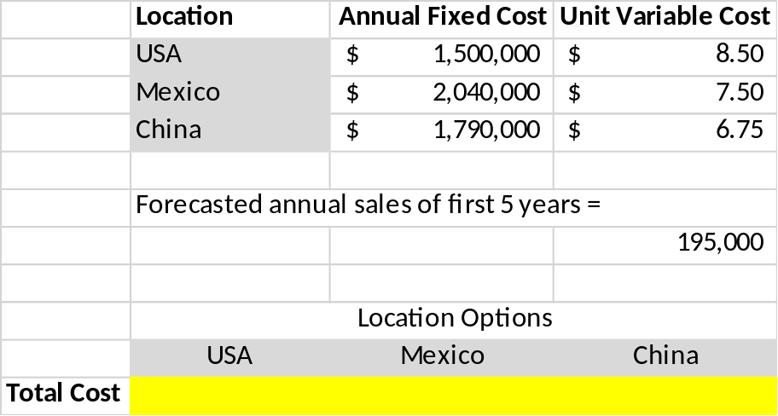
Learning Activity
Global Break-Even Analysis

Slide 44
Transportation Specialists (1 of 6)
Freight forwarders
  Two types of domestic freight forwarders:
    Surface
    Air
  Exists by offering a service to shippers that must use LTL rates because they do not generate enough volume to use TL rates
  Typically offers pickup and delivery service but does not perform the line-haul service (done by motor carriers or railroads)

Slide 45
Transportation Specialists (2 of 6)
Freight forwarders
  Give volume discounts to customers shipping large quantities of freight at one time
  TL rates less than LTL rates because
    Shipper loads the goods, and consignee unloads trailer
    The load goes directly from shipper to consignee without passing through terminals
    Administrative costs are same regardless of load size

Slide 46
Transportation Specialists (3 of 6)
Air forwarders
  Consolidate shipments
  Tender to airlines in containers ready for loading
  Forwarders provide retailing function
  Airline provides wholesaling function
Shippers’ associations
  Similar to air and freight forwarders but are not-for-profit organizations
  Primarily focused on achieving the lowest rates for members

Slide 47
Transportation Specialists (4 of 6)
Brokers
  Companies that look to match a shipper’s freight with a carrier to transport it
  LTL shipments consolidate them and then give to motor carriers, freight forwarders, or shippers’ associations
  TL shipments, brokers retain a carrier and receive a portion of transportation charges

Slide 48
Transportation Specialists (5 of 6)
Third-party logistics companies (3PLs)
  Find clients with complimentary transportation needs to maximize equipment utilization
  Should reduce transportation costs to clients

Slide 49
Transportation Specialists (6 of 6)
Parcel carriers
  Parcels are packages weighing up to 150 pounds
  Parcel carriers are companies that specialize in transporting parcels
  Parcel carriers include:
    U.S. Postal Service – Retail Ground
    United Parcel Service (UPS)
    FedEx Express
    Greyhound Package Express

Slide 50
Transportation Regulation (1 of 8)
The five modes are influenced by federal, state and local government regulations
  Examples:
    Mandatory retirement age for pilots in U.S.
    Placement of lighting on truck trailers
    Driver on-the-road hours
Regulation
  Costs money
  Needs to be codified
  Is enforced by government agencies

Slide 51
Transportation Regulation (2 of 8)
Level and degree of regulation varies from country to country
  Examples….
Logisticians must understand:
  Relevant transportation regulations
  Cost and service implications of regulations

Slide 52
Transportation Regulation (3 of 8)
Environmental regulation
  Environment Protection Agency (EPA) is the federal regulatory agency established to protect human health and the environment
  Current concerns include:
    Noise and air pollution
    Resource conservation

Slide 53
Transportation Regulation (4 of 8)
Safety regulations by:
  Department of Transportation (DOT) is the federal agency responsible for transportation safety regulations for all five modes
  Federal Aviation Administration (FAA) has primary responsibility for air transportation safety
  Federal Motor Carrier Safety Administration (FMCSA) is focused on reducing crashes, injuries, and fatalities involving large trucks and buses
  and….

Slide 54
Transportation Regulation (5 of 8)
Safety regulations by
  Office of Pipeline Safety (OPS) is responsible for safety considerations for natural gas and liquid pipelines
  Federal Railroad Administration (FRA) has primary responsibility for safety in the U.S. railroad industry
  U.S. Coast Guard (USCG) has three broad roles associated with marine (water) transportation:
    Safety
    Security
    Stewardship

Slide 55
Transportation Regulation (6 of 8)
Economic regulation
  Refers to control over business practices and activities such as entry and exit, pricing, service, accounting and financial issues, and mergers and acquisitions
  Regulation began in the 1870s due to a belief that transportation companies would not act in the public’s best interest without government regulation³
³Donald V. Harper, Transportation in America, 2nd ed. (Englewood Cliffs, NJ: Prentice Hall, 1982), Chapter 19.

Slide 56
Transportation Regulation (7 of 8)
Economic regulation history
  Resulted in two key economic regulatory bodies:
    Interstate Commerce Commission (ICC)
    Civil Aeronautics Board (CAB)

Slide 57
Transportation Regulation (8 of 8)
Economic regulation
  Deregulation began in the 1970s
    CAB was eliminated in 1985
    ICC was legislated out of existence in 1995
  A new agency, the Surface Transportation Board (STB), was created
  Economic deregulation has allowed greater freedom with respect to pricing and service options

Slide 58
Legal Classification of Carriers (1 of 3)
Transportation carriers are classified as either:
  For hire
    Common
    Contract
    Exempt
  Private
Classification is important because different levels of economic regulation are applicable to different carriers

Slide 59
Legal Classification of Carriers (2 of 3)
For-hire carriers
  Common carriers
    Serve the general public
  Contract carriers
    Offer specialized service to customers on a contractual basis
    No obligation to serve the general public or to treat customers on an equal basis

Slide 60
Legal Classification of Carriers (3 of 3)
For-hire carriers
  Exempt carriers
    Exempted from economic regulation due to legislation
Private carriers
  Companies whose primary business is other than transportation and provide their own transportation service
  Also exempt from economic regulation

Slide 61

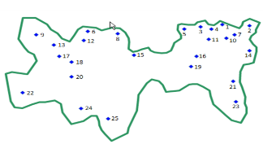
Learning Activity
Where to locate within a country/region?
The Gravity Method!

Slide 62
Reminders
Assignment
  Final Project
    Report
    Analysis
    Presentation
Final Exam

Slide 63
Next Time
Supply Chain Management
Partnerships within the Supply Chain
  See three extra readings
Final Exam Review

